Slide 1



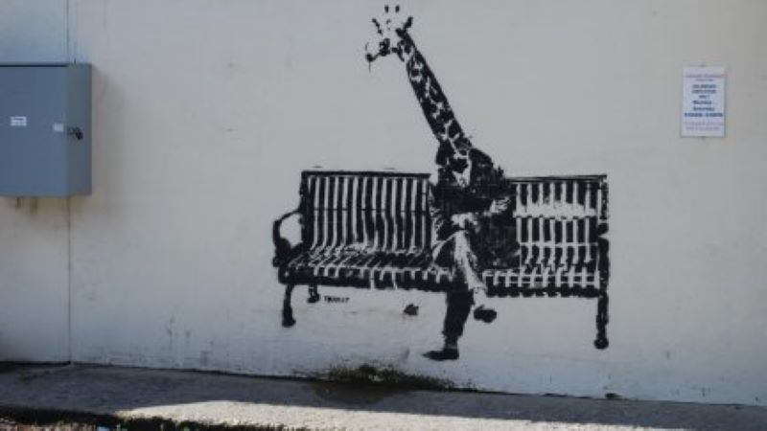



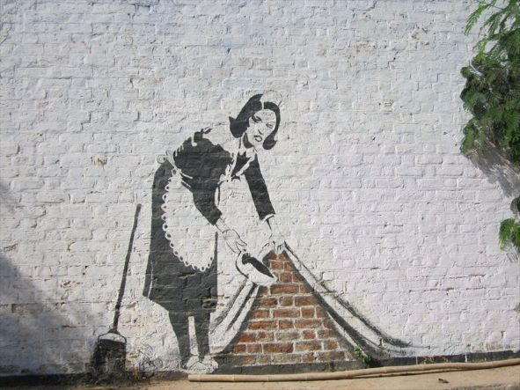
Colour Palette
Typography
Title: 100px; Bold; Default font
Subtitle: 45px; Bold; Default font
Text: 17px; Normal; Default font
Icons
Images
PNG and JPEG format

